Slide 1

Research Progress Record
Enmao Diao
July 28, 2018

Slide 2
Abstract
Video Change Detection
Data
Method
Metric

Slide 3
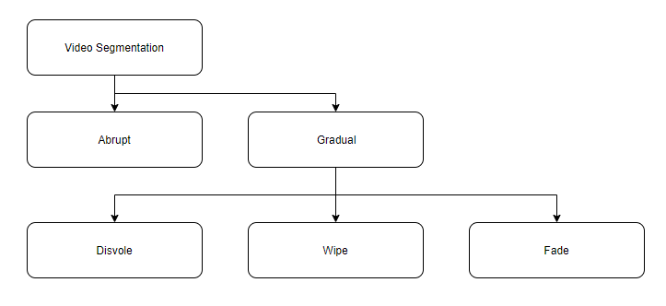
Video Change Detection
Shot Boundary Detection is important overall for scene change detection.
Shot is defined as a part of the video that results from one continuous recording by a single camera. The gap between two shots is called a shot boundary.

Slide 4
Types
1. Abrupt-Abrupt transition occurs in a single frame.
2. Gradual-Gradual transitions are more difficult to detect as the difference between frames corresponding to two successive shots is substantially reduced
a. Fade: Two different kinds of fades are used: The fade-in and the fade-out. The fade-out emerges when the image fades to a black screen or a dot. The fade-in appears when the image is displayed from a black image. Both effects last a few frames.
b. Dissolve: It is a synchronous occurrence of a fade-in and a fade-out. The two effects are layered for a fixed period of time e.g. 0.5 seconds (12 frames). It is mainly used in live in-studio transmissions.
c. Wipe: This is a virtual line going across the screen clearing the old scene and displaying a new scene. It also occurs over more frames. It is commonly used in films such as Star Wars and TV shows.
d. Maybe more?

Slide 5
Data
TRECVID
seven TRECVID releases, from 2003 to 2007. They have a total of 3,831,648 frames, with 8,545 gradual and 14,602 abrupt transitions.[1]
Data link
https://www-nlpir.nist.gov/projects/trecvid/past.data.table.html
Abundant dataset. Old, hard to get, hard to preprocess(?)
[1] A. F. Smeaton, P. Over, and A. R. Doherty, “Video shot boundary detection: Seven years of trecvid activity,” Computer Vision and Image Understanding (CVIU) ), vol. 114, no. 4, pp. 411–418, 2010.

Slide 6
Data
BBC Planet Earth dataset
ground truth shots and scene annotation for each of the 11 episodes of the BBC Planet Earth educational TV Series. Each shot and scene has been manually annotated and verified by a set of human experts.[2]
Each has about 50 minutes. Abundant, ready to use.
RAI(Rai Scuola video archive)
987 shot boundaries, 724 of them being hard cuts and 263 gradual transitions, 10 episodes. [3]
Each has about 10 minutes. Small, ready to use.
[2] Baraldi, Lorenzo, Costantino Grana, and Rita Cucchiara. "A Deep Siamese Network for Scene Detection in Broadcast Videos." In Proceedings of the 23rd Annual ACM Conference on Multimedia Conference, pp. 1199-1202. ACM, 2015.
[3] L. Baraldi, C. Grana, R. Cucchiara, Shot and scene detection via hierarchical clustering for re-using broadcast video, CAIP 2015

Slide 7
Data
OSVD(Open Video Scene Detection Dataset)
6 episodes with shot annotation and plus 15 episodes with scene annotation. Each has about 10 minutes.
Data link
https://www.research.ibm.com/haifa/projects/imt/video/Video_DataSet.shtml
[4] Daniel Rotman, Dror Porat, and Gal Ashour. "Robust and Efficient Video Scene Detection Using Optimal Sequential Grouping." IEEE International Symposium on Multimedia (ISM). IEEE, 2016. (pp. 275-280).

Slide 8
Methods
Classical [4]
Color Histograms
frame-to-frame similarities based on colors which appeared within them
Edge Detection
detecting edges in two neighboring images and comparing these images
etc
Deep Learning
CNN-based [5][6]
Metric
[1]
[4] Mithlesh, Chandra Shekhar, and Dolley Shukla. "Detection of Scene Change in Video. " 2013
[5] Hassanien, Ahmed, et al. "Large-scale, fast and accurate shot boundary detection through spatio-temporal convolutional neural networks." arXiv preprint arXiv:1705.03281 (2017).
[6] Gygli, Michael. "Ridiculously fast shot boundary detection with fully convolutional neural networks." arXiv preprint arXiv:1705.08214 (2017).

Slide 9
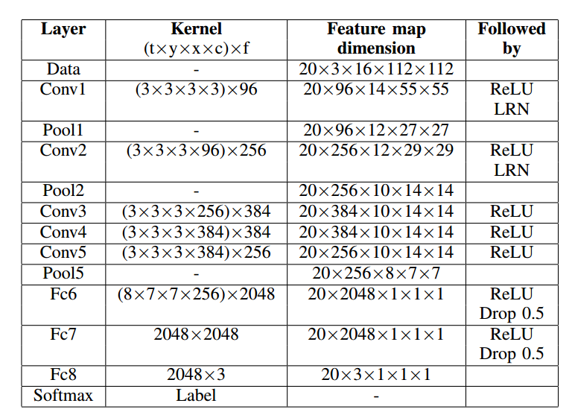
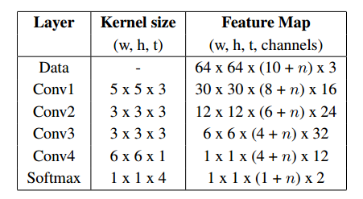
Methods
3D-CNN[5][6]
The network is given an input of 10 frames, and trained to predict if frame 6 is part of the same shot as frame 5. By providing 20 frames, the network would predict labels for frames 6 to 16[5]
If a frame is part of a transition such as a dissolve, it is labelled as not the same shot as the previous, as it is part of a transition, not a shot. [5]
Each segment is assigned one of three labels: 1) sharp transition, 2) gradual transition or 3) no transition. [6]
[5] Hassanien, Ahmed, et al. "Large-scale, fast and accurate shot boundary detection through spatio-temporal convolutional neural networks." arXiv preprint arXiv:1705.03281 (2017).
[6] Gygli, Michael. "Ridiculously fast shot boundary detection with fully convolutional neural networks." arXiv preprint arXiv:1705.08214 (2017).

Slide 10
Metric
Standard TRECVID evaluation metric
A transition is detected if it overlaps with the annotations by at least one frame.
Classification
Each frame has a label indicating whether current frame is in a transition or not
F1 score should be reported since change is rare.

Slide 11
Our Approach
Step 1:
Use Deep Model to extract features. Since Conv3D has been done, we can try LSTM_Conv2D or use off-the-shelf model
Step 2:
Instead of add SoftMax and do classification, we can use features from Step 1 to do time-series change point detection. With a proper distance metric, we can conduct hypothesis test.
Step 3:
Build a dictionary of transition state and in Step 2 we can determine newly arrived frame is inside the existing state or not.

Slide 12
Our Approach
We can either use labeled data to train the feature extractor in Step 1 or use off-the-shelf model. Since the classification step is omitted in our approach, we are not restricted to retrain the model with labeled data.
With different threshold in the hypothesis test, we can control the sensitivity of change
We can have multiple state representing abrupt shots, gradual shots and scenes. Using Classification, we need to prescribe and label specific type of transition. Without classification(fully-connected) layer we are able to dynamically adjust our dictionary which indicates possible state or class in the video

